Slide 1
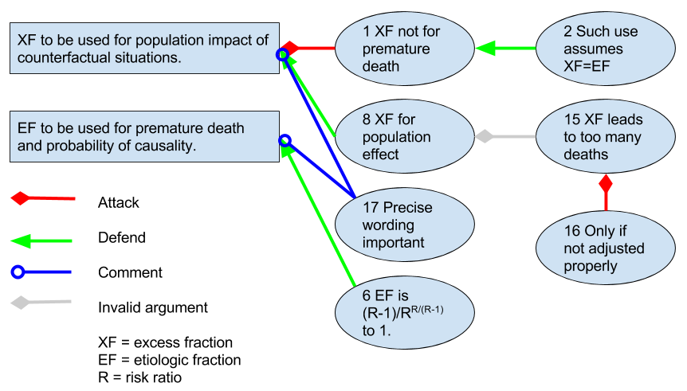


Discussion rules as a method to resolve scientific disputes:
Case attributable risk of air pollution
ISEE, 1-4 September 2016, Rome, Italy
Introduction
In the science-policy interface, we need better tools to document and resolve scientific disputes. We tested whether a set of participation rules and information structures can help. We aimed at understanding of key issues, not at mutual agreement of participants.
Methods
The information produced by participants is developed into web-based information objects. Topic is defined as research questions, and all content is evaluated against capability to answer the questions. With disputes, content is summarised into statements and organised hierarchically into a tree of attacking or defending arguments. Successfully attacked arguments are invalidated.
Materials
The case was a scientific dispute about how to estimate attributable deaths of air pollution in Lelieveld et al., Nature 2015: 525(7569):367-71. Discussion between the authors and critics, supplemented by scientific literature, was organised to identify and clarify the essence of the dispute. Several issues highlighted by the information structure were taken to further scrutiny. The work produced a method web page about the resolution.
Results
Dispute: what fraction to use
Based on the resolution of the structured discussion, we found out that Lelieveld et al made a common mistake about terms assuming that the two are the same.
Premature mortality refers to individuals who died earlier because of exposure to a pollutant and is estimated with etiologic fraction. Excess fraction is the proportion of exposed cases that would not have got the disease during a defined time period without exposure on population level.
Premature mortality cannot be estimated based on RR only, while excess risk can be estimated with (RR–1)/RR, where RR is the risk ratio.
Conclusions
Disputes about even heated and controversial topics can be clarified, understood or even resolved by using a set of rules for participation and information synthesis. Such systematic description of participants’ views is called shared understanding, and it seems a useful concept in communicating such processes.
The rules should be tested in resolving scientific disputes on a large scale. If successful, the use of science in the society could benefit from practices of open collaboration.
http://en.opasnet.org/w/Attributable_risk
Diagram of a few key arguments related to the use and interpretation of excess fraction (XF) and etiological fraction (EF). Attack invalidates an argument, which then does not affect the outcome. Numbers refer to argument numbering in the full structured discussion.
Rules used in organizing scientific information in a collaborative workspace.
Shared understanding An important objective is to produce shared understangins among participants. It is a situation, where participants' views have been described thoroughly enough to know which facts, opinions, and values relate to the topic at hand; and where there are agreements and where disagreements and why.^{[1]} Openness All information about the topic is available all the time.^{[2]} Anyone can participate in the work at any time and affect the outcome.^{[3]} Only the content and quality of contributions matter, not e.g. prestige of participants. Shared information objects All information is shared using a systematic structure and a common workspace where all participants can work. Also edits to the information are done in the workspace to maintain a master copy and reduce a need for duplicate versions.^{[4][5]} The structure of objects has three parts: question, answer and rationale. 1) Objectives determine the information needs, which are then used to formulate research questions to be answered. 2) The work is collaboration aiming to answer these questions in a way that holds against critique. 3) Rationale contains all information (e.g. data, analyses, and discussions) that is needed to convince a critical rational observer. The information system consists of items and their relations. Items are typically knowledge crystals. There are a limited number of relations, and they are used as properties in an RDF semantic database.^{[6]} Linux approach: Anyone can participate in developing developing information (just like code for Linux) using any tools. However, the closer to the mainline we come, the stricter rules will be implemented. | Critique All information presented can be criticised on scientific grounds. The aim is to reject ideas and hypotheses that do not hold against critique^{[2]}. In complex topics, critique is organised into a hierarchical argumentation structure following these rules.^{[7]} The purpose of argumentation is not to replicate all discussion that went on but describe the logic of arguments. Similar approach is used in Linux development when code improvement patches are described.^{[8]} A statement or a set of exclusive statements is identified. A statement can be attacked or defended with an argument. Also other arguments can be attacked and defended in a hierarchical manner. Attacks can only be made based on relevance or accordance with observations of the attacked argument. If successfully attacked, the argument becomes invalid and does not affect the resolution of the argumentation. However, the argument is kept visible in the structure to prevent repetition of the same mistake. The resolution of the structured argumentation is a synthesis of all valid statements. Knowledge crystal An objective is to produce knowledge crystals from the information. They are information objects that follow the rules mentioned above and aims at shared understanding about a topic.^{[1]} Intentionality The problem owner of the information object explicates their objectives related to the object. Often the objective is simply to answer a research question, but in many practical situations the information is needed to support a particular decision in the form of an assessment. Context may affect information needs.^{[5]} | Causality The focus is on understanding and describing causal relations between the issues related to the topic.^{[5]} Reuse All information is produced in a way that can easily be used for other purposes by other people. For example, some file formats or copyright licenses hinder reuse.^{[5]} Co-creation skills and facilitation The problem owner invites enough people with expertise on both substance and co-creation to produce high-quality information in a high-quality format.^{[5]} Evaluation and management Participants describe the progress of the work continually and clearly. The problem owner evaluates the situation against explicit objectives and manages the work with further guidance.^{[5]} Grouping During the work problem owner makes sure that the participants feel a part of such a group who cares about the participants' contribution and whose work has societal importance.^{[9]} Respect Problem owner gives public respect to participants based on the importance of their contributions. Contributions are evaluated by crowdsourcing.^{[9]}
Affiliations
1. National Institute for Health and Welfare (Depatrment of Health Protection), Kuopio, Finland.
2. Harvard School of Public Health, Boston, MA, USA.
VALTIONEUVOSTON
SELVITYS- JA TUTKIMUSTOIMINTA
www.tietokayttoon.fi.

