Slide 1
Climate change policies (HW4 by Oluwatobi Abayomi Badejo et al)
Presented by Mohammad Shahidehnia and Paula Maatela

Slide 2
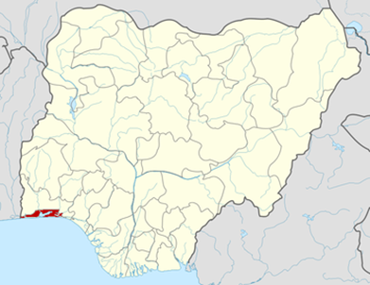
Nigeria
Location of Lagos State in Nigeria
is a federal constitutional republic comprising 36 states.
Nigeria is located in West Africa.
Population 174,507,539 million.
Lagos is the most populous city in Nigeria.
Lagos is the second fastest-growing city in Africa and the seventh in the world.
The population in Lagos is about 20 million.

Slide 3
Question
What are the multisectoral frameworks for mitigation and adaptation in response to climate change issues in Lagos, Nigeria?

Slide 4
Users and intended use
Business owners, policy makers and populace can use the information to plan their daily activities in environmentally friendly way.
Business owners like industrialists will use the outcomes of the assessment in regulating gaseous emissions and waste disposal.
Policy makers will use the report in development of enforcement policies and its implementation.
The populace will use the information in checking and giving feedbacks to government on impacts of different organizations operation as it affects survival.

Slide 5
Participants
Corporate organizations, government agencies, community leaders and populace. All the aforementioned stakeholders have to contribute to the assessment to ensure its acceptability and effectiveness.

Slide 6
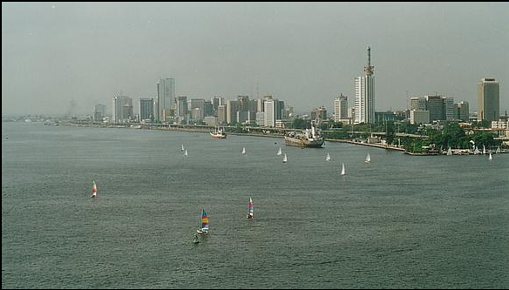
Boundaries
The assessment was carried out between 2012-2014 (2 years) in Lagos State, South-Western Nigeria with a population of over 20 million people.
It is estimated that 3.2 million Nigerians in Lagos state could be displaced from their homes by Sea level rises.
Over 2 million of these people live in Greater Lagos and other urban areas.
Unique features of Lagos State such as a high and rapidly increasing population, the flat topography, extensive coastal areas and a high water table, which in some areas of Lagos Island is less than 0.15 m from the surface, are predisposing factors that further increase the State’s vulnerability to climate change impacts.

Slide 7
Decisions and scenarios
To review the existing landscape of institutions and organizations involved in generation of climate change data, information and knowledge systems requisite for policy making and planning.
Develop a mechanism for climate change information and knowledge sharing platform to facilitate sharing of climate information and knowledge.
Develop a climate change education, information and awareness plan.
Promote social protection programmes for vulnerable communities, households and individuals including women, men, children, youth, physically challenged and others.

Slide 8
Timing
The Policy was developed within 2 years and will be reviewed every three years to take into account emerging issues, challenges, and trends on climate change at the local, national, sub-regional, regional and global levels including the dynamic international climate change policy debate.

Slide 9
Answer
The policy established a state climate change governance frame work to coordinate and harmonize implementation of state level climate change activities.
Priority adaptation action areas were mapped out.

Slide 10
Results
Diversification of economies to reduce over dependence on climate-sensitive sectors and occupations.
Development of social protection as a tool for adaptation to climate change and risk reduction.

Slide 11
Conclusions
Adaptation and mitigation procedure as described in the policy is achievable and consistent with the realities of the Nigerian community due to the economic status of majority of people.

Slide 12
Stakeholders
Corporate organizations, government agencies, community leaders and populace.

Slide 13
Our evaluations
1. Is it possible to use the climate change adaptation policies which are done in Europe for Nigeria too?
It is possible, but if we take in to account the differences between countries in case of financial, weather conditions, community lifestyle and habits.
2. Does Nigeria get any help from other countries?
Organizing seminars with Europe participants such as Germany for:
- Embedded energy
- Energy efficiency
- Biogas and biomass
- E-waste management.

Slide 14
Babatunde Raji Fashola, SAN Governor of Lagos State speech on 7th Lagos State Climate Change Summit held on April 21, 2015
After planting over 5 million trees, creating 196 parks and over 90,000 jobs that did not exist before, and a Parks and Gardens Agency created for maintenance and sustainability.
In the area of Energy Conservation, 5 (Five) Independent Power Plants have led to the reduction of power costs in running some critical public utilities likes schools, court rooms, water works, hospitals and police stations, by close to 40%.
They have used cleaner fuel, mainly gas, and led to the decommissioning of 400 (Four Hundred) generators and an annual CO2 emission reduction of 1,017,000,000 lbs leading to a cleaner environment by the reduction of pollution.
Drainage interventions across the State have consigned flooding in places NTA at Ahmadu Bello Way Victoria Island, Lekki Expressway, Idi-Araba LUTH, Arigbanla in Agege, Iddo and UNILAG back gate to history.
Related action to our assessment:
The Eko Atlantic City Project, the new wall of Lagos on the Atlantic is already achieving its objective of protecting Lagos from flooding; even before the city is fully built.

