Slide 1
Overall approach of Ilves consortium: do you agree that this is important?
Sakari Kuikka & Inari Helle, Riikka Venesjärvi, Mika Rahikainen, Jani Luoto
Head of Fisheries and Environmental Management group (FEM), Department of Environmental Sciences, University of Helsinki, Finland, Email: sakari.kuikka@helsinki.fi
STECF member (EU main advisory body)
Focal point of International Ocean Institute in Finland

Slide 2
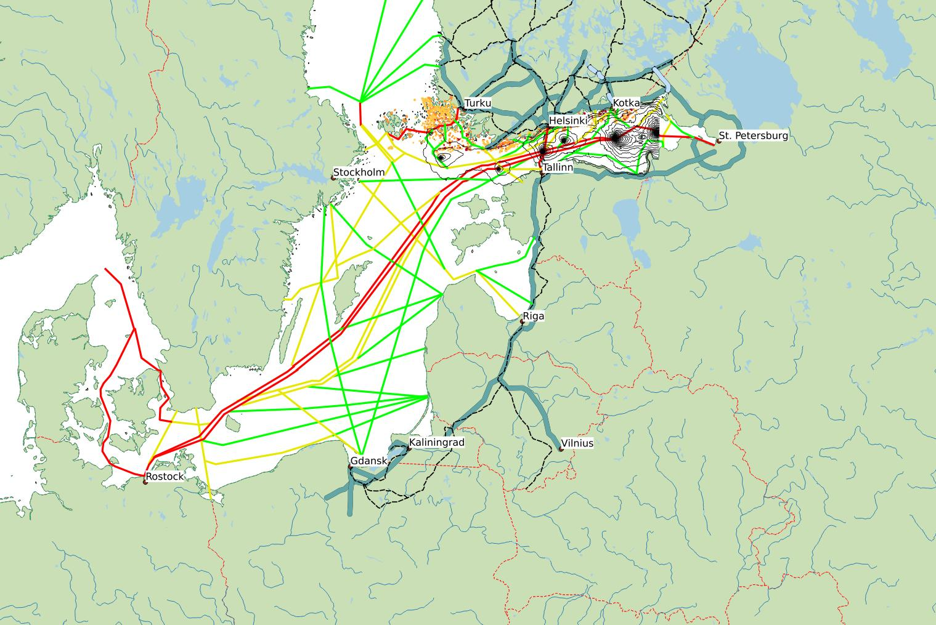
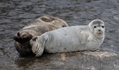
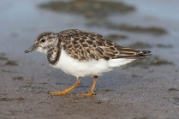
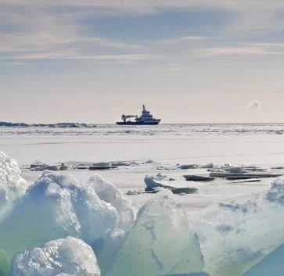
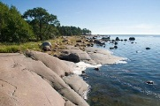
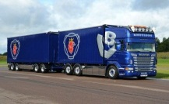
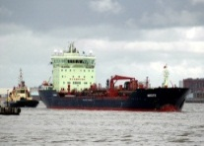
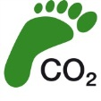
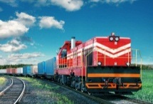
Threatened coastal species and habitats:
legislative responsibility
Critically endangered Saimaa ringed seal:
do we want to protect?
High investments on inland waterways in Sweden – why not in Finland?
Saimaa canal versus new Kymi canal:
political safety?
Amount of maritime traffic?
Likely accident spots and probabilistic spreading of oil (Lehikoinen et al. 2015 in Env. Sci. Tech.; Helle et al., submitted to Ecosphere)
Tunnel option between Helsinki and Tallinn:
major risk management action
Winter navigation: new risks?
The ILVES approach
My CO₂
Credit card
Number of cargo trains?
Intensity of CO₂ emissions caused by maritime traffic:
can we reduce?
(red=high, yellow=moderate, green=low)
Amount of heavy truck traffic?

Slide 3
The ILVES approach
Learning from history > prior knowledge
WP 1) Analysis of historical data and meta-analysis of publications
WP 2) Structuring decision model, inserting policy causal knowledge and value-of-information analysis
Learning from economics
Development of fast algorithms for decision models
Publication in refereed journals
WP 3) Answering to the probabilistic questions of decision models: data analysis and algorithm
WP 5) Planning the future policy options: value of control analysis and the use of new causal interventions
Description of losses for cost-benefit analysis
Testing and communicating
WP4) Health and well-being impacts of oil spills in Saimaa
New waterway assessment
WP 6) Software development and test with people out there
WP 7) Dissemination: talking and saving the talks and feedback, open science

Slide 4
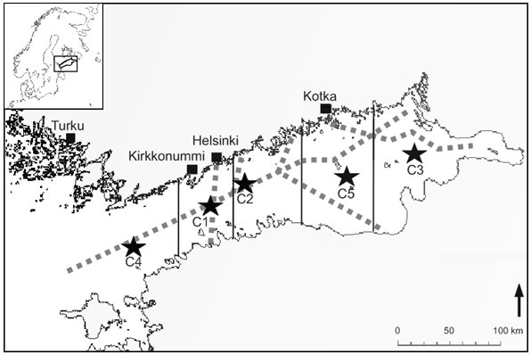
Gulf of Finland and oil
Lehikoinen et al 2013. Env. Sci. Techn. DOI: 10.1021/es303634f

Slide 5
UH /FEM Coordinator:
Leadership, Bayesian analysis, decision models
WP1: Analysis of historical data and meta-analysis of publications
FMI: Emission and vessel traffic models
WP 2: Structuring decision model, inserting policy causal knowledge and value-of-information analysis
KMRA: Stakeholder contacts and dissemination
UH/ECON: Alternative theories given the data and existing publications
UH/STAT: Causal learning from non experimental data
WP 3: Answering to the probabilistic questions of decision models: data analysis and algorithm
Aalto: ??????
Hugin: Interactive software development
VATT: Economic data, spatial economic models
CSIRO: Optimal insurance laws
WP 4: Health and well-being impacts of oil spills in Saimaa
UnivWaikato: Describing risk in an understandable way
ÅA: Existing and new legislation
NHA: Experiences in risk communication
WP 5: Planning the future policy options: value of control analysis and the use of new causal interventions
KYAMK: Potential risks of inland waterways
LUT: Logistic solutions and information needs of companies
WP 6: Software development and test with people out there
WP 7: Dissemination
Citizen activities???????????????????

Slide 6
Policy options
VETTING INDICATORS
Emergency
preparedness
Safety management
?
False
check lists
Maintenance
Crew competence
Vetting practises
Ship operations
Training
Ship safety
PSC practises
?
Communication
Oil spill accident
NGOs
Incident reporting
Oil accident probability | Poor safety level | Moderate safety level | Good safety level
0-25%
25-50%
50-75%
75-100%
Notes:
We will recognise the best practises in private oil company safety management (e.g. vetting practises) and assess how those can be transfered to national management (e.g. PSC). In addition, we will to recognise the possible harmful side effects of policies and actions (dashed lines), and study by which methods those can prevented (red cross). Thus, we aim to improve the tools for maritime safety and reduce the probability of oil accidents. The higher depencies are marked with larger arrows. In matrix, darker color describes higher probablity.
Model is applied from publication Hänninen, Maria; Valdez Banda, Osiris A. and Kujala, Pentti. Bayesian network model of maritime safety management. Expert Systems with Applications, 41, 7837–7846, December 2014.

