Slide 1
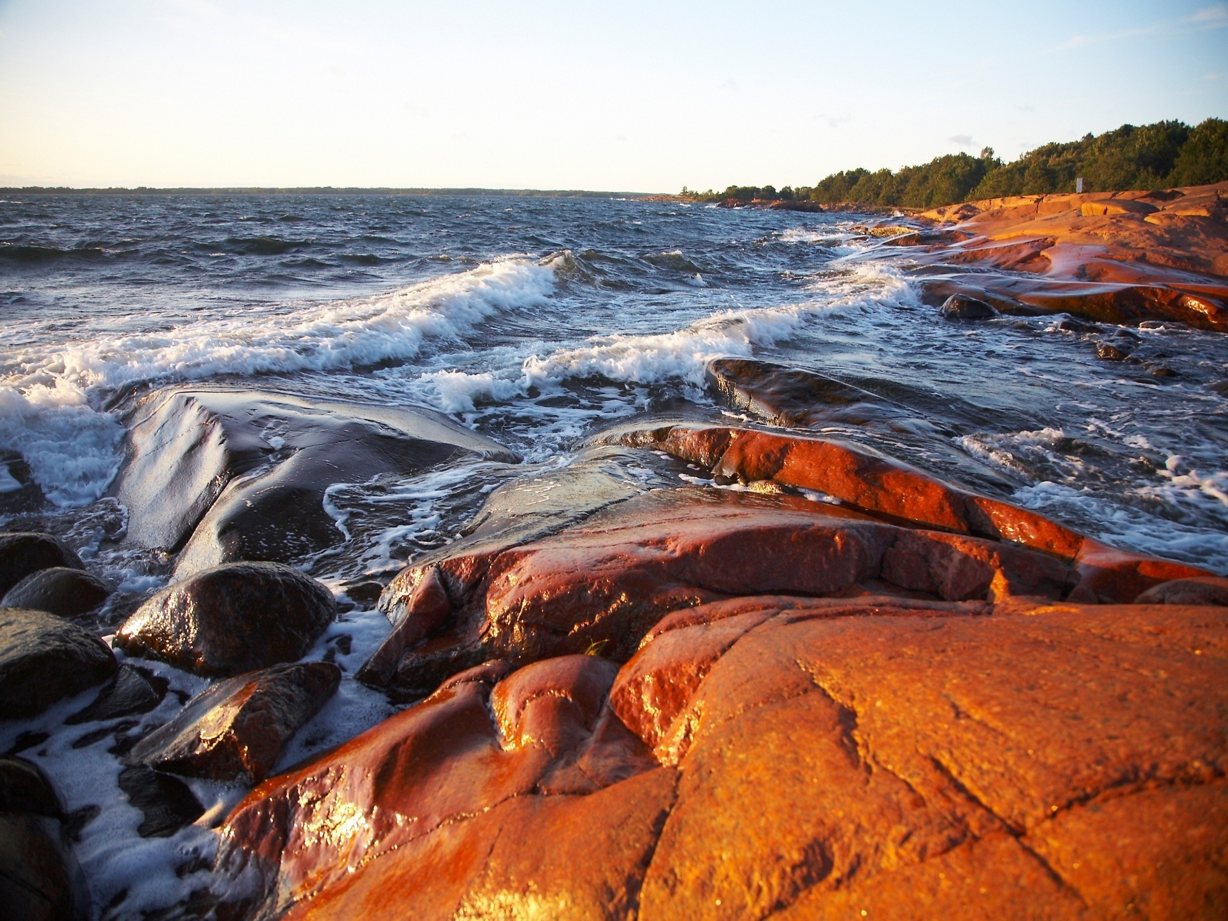


BONUS GOHERR
Annual meeting 2016
BONUS PM Andris Andrusaitis

Slide 2
Second reporting period
INSPIRE Second periodic report
Scientific report ☑
Publishable summary ☑
Performance statistics ☑
Finances ☑
Actually, GOHERR was the first of the SES projects which had its 1st PR approved!
Congratulations !!!

Slide 3
First reporting period: higlights
GOHERR stakeholder work during the first period (March 2015-April 2016) revealed that although the public image of herring as food is poor, which leads to market situation where herring catches go mainly for fish meal, fish oil and animal feed, stakeholders consider increasing the human consumption of Baltic herring desirable. GOHERR has identified several plausible ways to increase the future (2040 horizon) use of herring as a source of healthy food despite of the dioxin problem.
By compiling and re-analysing salmon stomach content data GOHER has confirmed specifics of salmon feeding in different parts of the Baltic Sea: it is dominated by herring in the northern parts and sprat in the southernmost parts. The stomach data also show a significant amount of stickleback in the diet of salmon. Most importantly for understanding the prey-predator interactions between Baltic herring and salmon (which is crucial for multi-species management), the GOHER scientists have identified co-variation of the prey fish size with the size of salmon.

Slide 4
Third reporting period

Slide 5
Project clustering in 2017
Cluster activity | Potential participating projects | Lead | Time, place | Comment
The second drafting workshop on an integrative concept paper along the lines of the 2015 summer school topic "The Baltic Sea: a model for the global future ocean?" | BAMBI, BALTICAPP, BIO-C3, COCOA, GO4BALTIC, INSPIRE, MIRACLE, SOILS2SEA | BIO-C3 | Early July 2017, Kiel or vicinity | The first drafting workshop will take place as planned on December 6-9 2016. Team is planning to hold the 2nd workshop right after the BIO-C3 annual meeting, June 26-29 2017. Manuscript will be produced by the end of 2017. OA publishing cost will be decided separately.
Notes:
This and the further 6 slides present the draft plan for projects clustering activities in 2017. This plan will be submitted for approval by the BONUS steering committe on 11 October. Projects will be informed about the outcome.

Slide 6
Project clustering in 2017 (ctd)
Cluster activity | Potential participating projects | Lead | Time, place | Comment
A workshop on creating a Regional Exploitation Platform foe Earth Observation. | ESABALT, FERRISCOPE, GEOILWATCH, + two new projects currently in negotiation | BONUS Secretariat | 29-30 March 2017, Helsinki | This workshop will produce a summary the main findings and recommendations for dedicated scientific activities, applications development, service innovation and underlying ICT capabilities for a wide spectrum of users (scientific, institutional, private sector, international bodies). BONUS support may include travel costs for representatives of the finished BONUS projects whose participation in the workshop is critical.

Slide 7
Project clustering in 2017 (ctd)
Cluster activity | Potential participating projects | Lead | Time, place | Comment
A drafting workshop on future socio-economic scenarios for the BSR. The aim is to produce a review paper. | BAMBI, BalticAPP, BIO-C3, COCOA, Go4Baltic, GOHERR, MIRACLE, INSPIRE, SHEBA, SOILS2SEA OPTITREAT | BALTICAPP | TBD | The options were discussed at the Scenario workshop Helsinki, April 2016. Further actions would include (plan A) preparation and publishing of e.g. an AMBIO special issue (OA) analyzing the issue from the perspectives of different sectors, or (plan B) producing one larger review paper on the matter of standardizing climate and socio-political scenarios for the BS region.

Slide 8
Project clustering in 2017 (ctd)
Cluster activity | Potential participating projects | Lead | Time, place | Comment
A joint Technology Transfer workshop as a side-event of the Baltic Sea Science Congress. Aaim is to inform the scientific community about emerging new measurement opportunities, fostering cooperation between developers and producers of new instruments. | CHANGE, FERRYSCOPE, FISHVIEW, GEOILWATCH, GOHERR, HARDCORE, INSPIRE, PINBAL AFISMON | BONUS Secretariat | June 2017, Rostock | Format and share of responsibilities is now being negotiated with the BSSC local organisers (IOW). This side event is planned as a half-day session with an exhibition of the new devices in close proximity if possible lasting the whole day or several days.

Slide 9
Project clustering in 2017 (ctd)
Cluster activity | Potential participating projects | Lead | Time, place | Comment
A clustering event in support of mitigating the Baltic Sea eutrophication by developing efficient policy measures and management practices, including cost-benefit analysis of combating eutrophication. | BALTCOAST, BALTICAPP, BALTSPACE, COCOA, GO4BALTIC, MIRACLE, PROMISE, SOILS2SEA | COCOA | Early autumn 2017, Stockholm? | The Baltic Sea Centre at Stockholm University has indicated their willingness to host this meeting. Desirable broad participation (potentially also including scientists outside the BONUS projects). The outcome of this activity could be a communication to the national governments and the Commission before the possible intermediate EU CAP update in 2017. More details will be agreed with J.Carstensen (COCOA) and B.Gustaffsson (SU BS Centre)

Slide 10
Project clustering in 2017 (ctd)
Cluster activity | Potential participating projects | Lead | Time, place | Comment
Joined INSPIRE and BIO-C3 end conference “Science delivery for sustainable use of the Baltic Sea living resources” | BIO-C3 INSPIRE Open for all BONUS projects and outside | INSPIRE BIO-C3 | 17-19 October 2017, Tallinn | This conference was already endorsed by ICES. Its proceedings will be published in a special issue of ICES Journal of Marine Science (IF(5y)=2.8). This conference will also be framed Estonia’s EC presidency event.

Slide 11
Project clustering in 2017 (ctd)
Cluster activity | Potential participating projects | Lead | Time, place | Comment
A clustering event addressing the generic issues of virtual decision support tools: common definition; a unified catalogue of the available tools and a common access point and a coherent user interface (e.g. the “BONUS toolbox”). | BALTCOAST, BALTSPACE, BALTICAPP, BAMBI, BIO-C3, BLUEPRINT, CHANGE, GOHERR, INSPIRE, MIRACLE, STORMWINDS | BALTSPACE | Second half 2017, Germany, near Hamburg | This activity could involve international expertise (e.g. ICES, USA, Canada, Australia etc.). The operational task could be to initiate the process; afterwards it can be taken further in a more systematic way. Andreas Kannen of HZG (leading the tools WP in BALTSPACE) is willing to take a lead. The level of ambition, cost estimate and other details must be further discussed.

