Slide 1
Impact Assessment Unit: interdisciplinary issues in environmental health risk assessment
Jouni Tuomisto
THL, Impact Assessment Unit, Kuopio
Notes:
http://en.opasnet.org/w/File:Open_policy_practice.pptx

Slide 2
Outline
The objective is to give an overview of our work in THL, motivate to learn more about our methods, and promote collaboration.
Case study of Helsinki energy decision 2015.
How open policy practice developed.
Some main principles
More examples of different assessments
Comparisons of approaches
Conclusion: An ideal world

Slide 3
Glossary
Open policy practice: a method for working in the science-policy interface
Open assessment: a study of impacts of the options of a particular decision
Knowledge crystal: an open information object answering a specific research question. Open assessment consists of these.
Opasnet: a web-workspace for making open assessments
Shared understanding: transparent reasoning; participants understand the views and opinions of others.

Slide 4
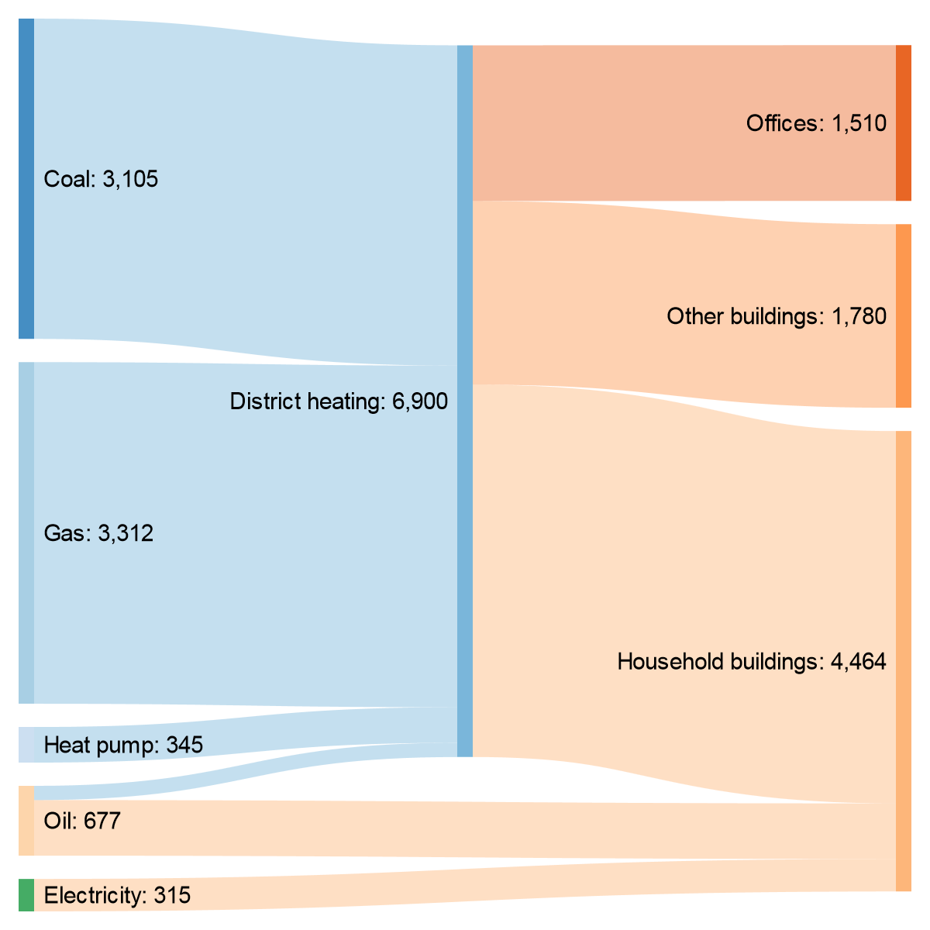
Energy production and consumption in the buildings of Helsinki
Notes:
http://sankeymatic.com/build/
' Type a list of Flows, like this:
' SOURCE [AMOUNT] TARGET
' Examples:
Coal [3105] District heating
Gas [3312] District heating
Heat pump [345] District heating
District heating [1510] Offices
District heating [1780] Other buildings
District heating [3610] Household buildings
Oil [138] District heating
Oil [539] Household buildings
Electricity [315] Household buildings
' After all your Flows are entered, use
' the controls below to customize the
' diagram's appearance.
' For even finer control over presentation,
' see the Manual (linked above).

Slide 5
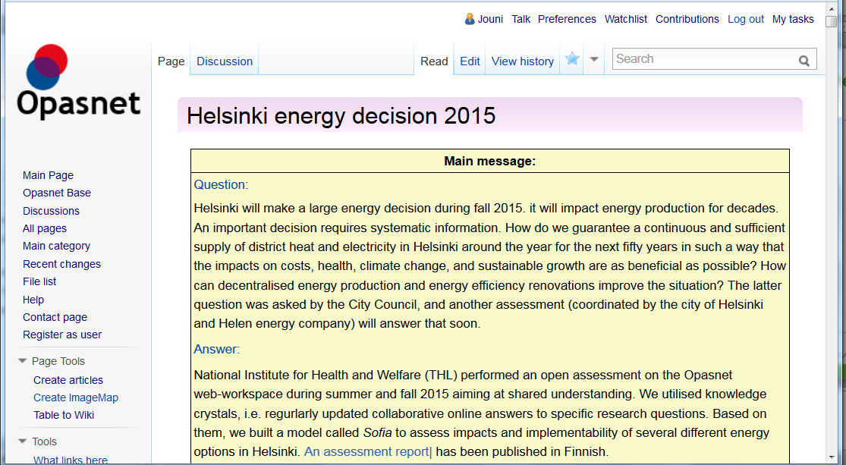
Helsinki energy decision
http://en.opasnet.org/w/Helsinki_energy_decision_2015

Slide 6
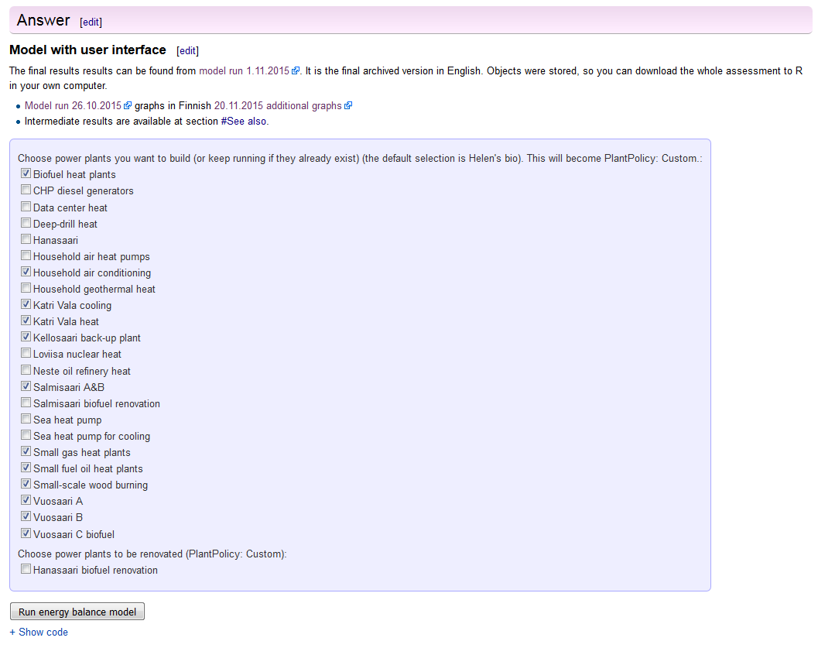
Online model of Helsinki energy decision with user interface

Slide 7
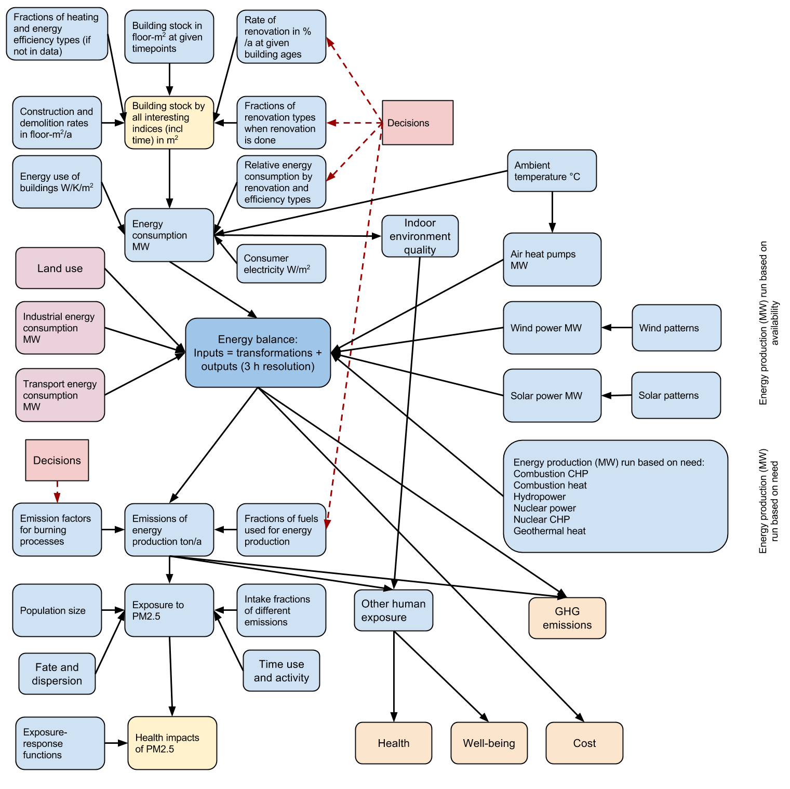
Assessment model for the Helsinki case

Slide 8
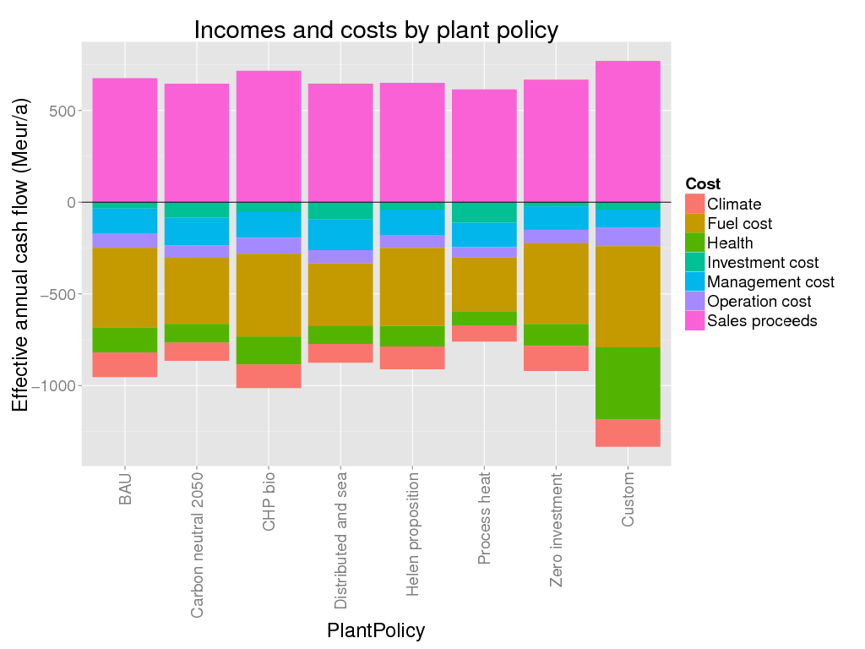
Impacts of different power plant options in Helsinki

Slide 9
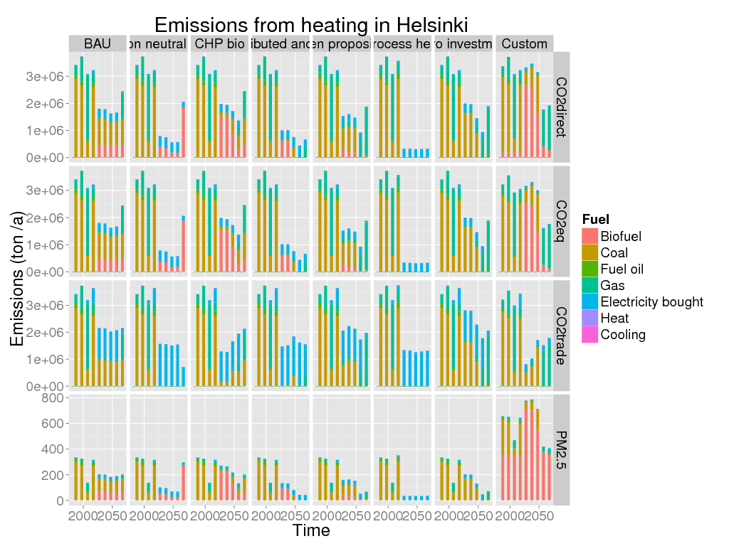
Emissions from heating in Helsinki

Slide 10
History briefly: borrowing and combining ideas
  1982: ”The future of mankind”
  1996: EU Parliament visit: ”Information does not flow!”
  1997: Pyrkilö = a thing that tends to gradually progress toward its objective (i.e. the truth in the case of Internet-based assessments)
  2000: Decision analysis (Harvard School of Public Health)
  2001: Rush hour in Boston → idea of composite traffic
  2005: Wikipedia, wiki approach
  2006: Opasnet wiki launched
  2006: Wikinomics, mass collaboration, wisdom of crowds
  2006: Argumentation rules (Amsterdam University)
  2007: Open assessment
  2009: Wiki government
  2011: Online wiki modeling using R
  2012: MongoDB: open database
  2013: Open policy practice (guidance for making decisions)
  2014-2015: Several policy projects without research funding

Slide 11
Research question for open assessment (2007)
How can scientific information and value judgements be organised for improving societal decision-making in a situation where open participation is allowed?

Slide 12
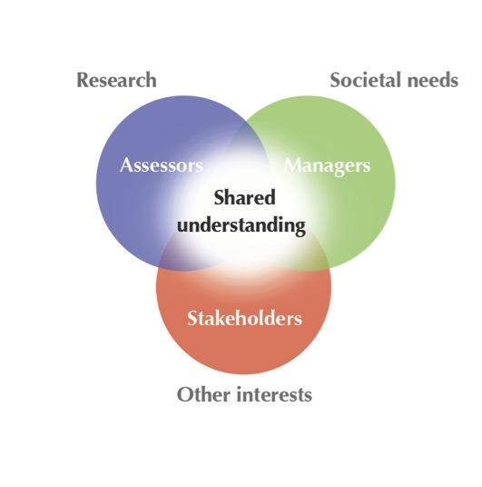
Engagement & Interaction
Shared understanding is a situation, where participants can describe what facts, values and objectives relate to the issue at hand, and where there are disagreements and why. In practice, this description is typically a written one.

Slide 13
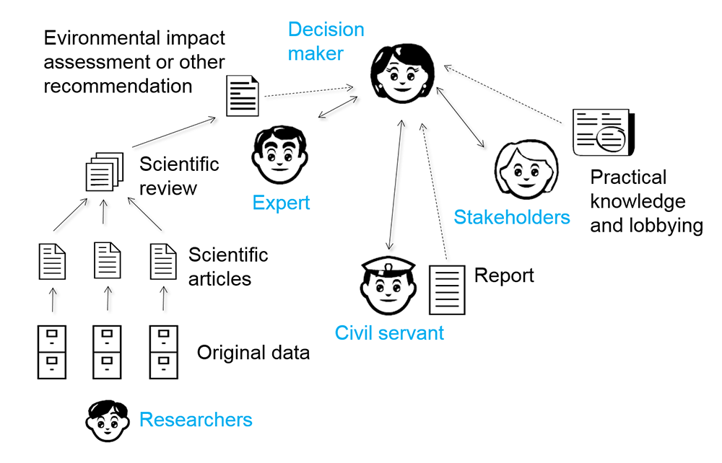
Information flow in traditional decision making

Slide 14
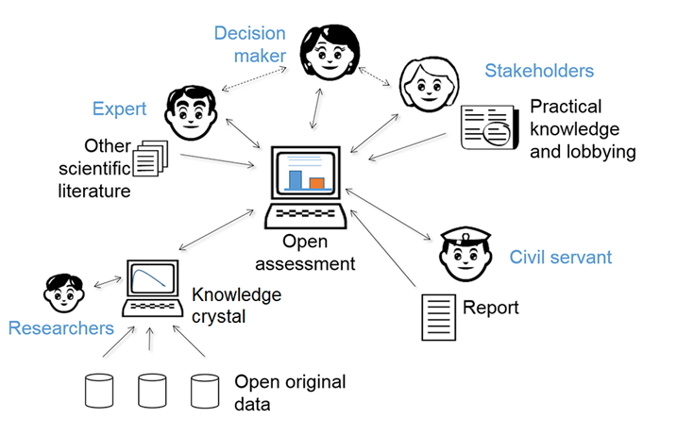
Information flow in an open assessment
Everyone has the same information and tools available.

Slide 15
Principles of open policy practice
Shared understanding
Openness
Shared info objects
Critique
Intentionality
Causality
Reuse
Co-creation skills and facilitation
Evaluation and management
Teamwork
Respect http://en.opasnet.org/w/OPP

Slide 16
Open assessments: examples
2005: Composite traffic: Is it cost-effective to aggregate trips into taxi-like vehicles in Helsinki? (Yes, with positive health and climate impacts.)
2004, 2009, 2015: Fish and health: Is fish unhealthy because of dioxins, especially in the Baltic Sea? (No)
2011: Swine flu vaccination: Was vaccination a bad idea because of the surprising narcolepsy side effect? (No)
2011: Russian duma election: Did Putin’s party United Russia cheat in the election? (Yes)
2012: US presidential election:Did Mitt Romney cheat in the Republican primary election? Possibly; data is too poor to tell)
2014: Pneumococcal vaccination: How to choose the product for the national program? (Based on price only.)
2015 Helsinki energy decision: Which power plant to choose? (Small differences re health and climate; city-level decisions are highly dependent on national electricity policy, but that does not exist.)

Slide 17
Strengths and opportunities
THL impact assessment team
  Open quantitative modelling
  R and open databases.
  Methods and web-workspace for knowledge work content.
Why not put everything in Wikipedia?
  Many things are best found when in Wikipedia, but…
  does not support primary data and primary research.
  does not support statistical analyses or models.

Slide 18
Ideal world
All knowledge about decisions is openly available.
Anyone can test, criticise, and improve knowledge AND decision options.
When something is scientifically falsified, it is not politically acceptable to use it as a basis for a policy.
Research institutes produce information always in the form of knowledge crystals also.
Knowledge crystals are used as an authoritative source of policy information because a) critique is embedded and b) performance is evaluated.
Because all knowledge crystals must be coherent, the number of plausible answers decreases like in Sudoku.
Slow thinking (as by Daniel Kahneman) defeats fast thinking when shared understanding is developed.

Slide 19
Practical steps toward the ideal world
EFSA crowdsourcing project would enable THL/GovLab collaboration on science policy development in Europe.
THL project with the Prime Minister’s Office promotes open policy practice in Finnish governance.
Start working with online tools only: use shared info objects.
Combine efforts to produce shared understanding with crowdsourcing methods.

Slide 20
End

Slide 21
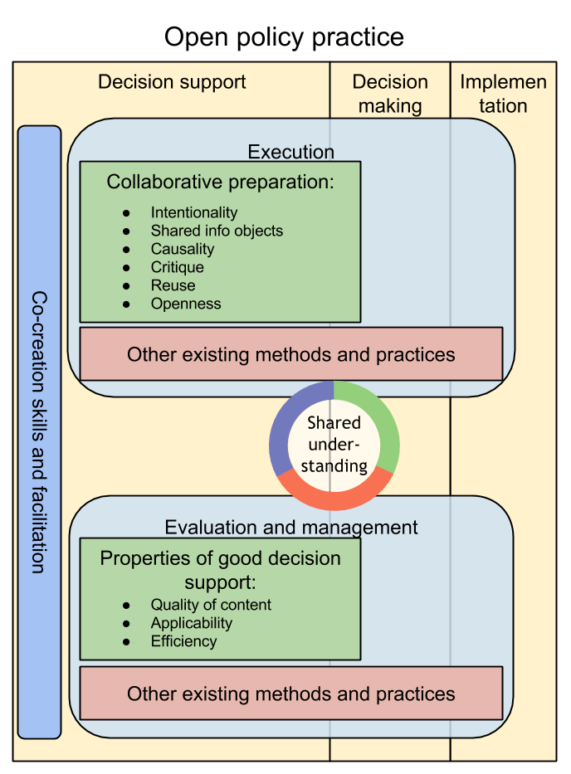
Open policy practice
Example assessment: Pneumococcal vaccine

