Slide 1
The Governance Lab
Jouni Tuomisto
THL, Kuopio

Slide 2
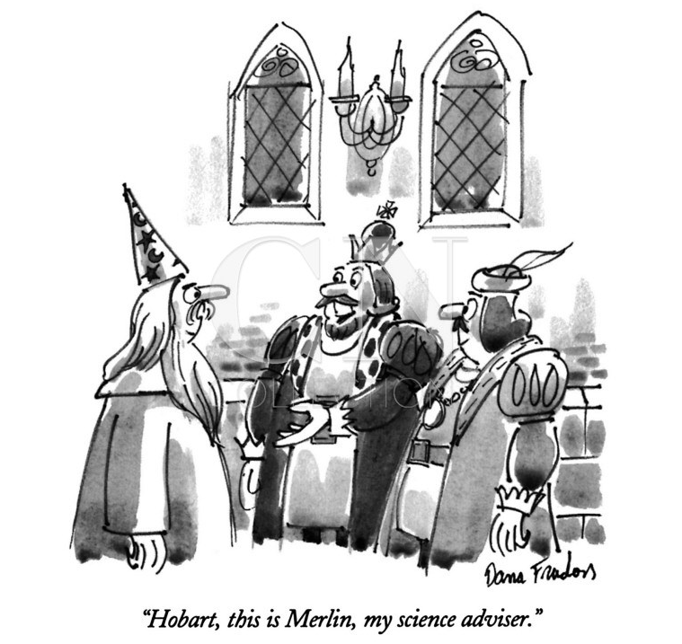
Assessments are to support decisions
It’s all about information flows between people to right places

Slide 3
Outline
Overview of the GovLab
The most interesting projects
OpenData500
Network of innovators
Demos for Democracy
Smarter citizens, smarter state
Randomized trials of practices
Knowledge crystals and Wikidata
What could THL do?

Slide 4
The Governance Lab
An institute based at New York University / Tandon School of Engineering.
Staff and students: About 30 from all over the world.
Lead supporters: MacArthur Foundation, Knight Foundation, Google.

Slide 5
GovLab’s mission
To improve people’s lives by changing the way we govern.
The goal is to strengthen the ability of institutions – including but not limited to governments – and people to work more openly, collaboratively, effectively and legitimately to make better decisions and solve public problems.
Increased availability and use of data, new ways to leverage the capacity, intelligence, and expertise of people in the problem-solving process, combined with new advances in technology and science can transform governance.
Each challenge and opportunity is approached in an interdisciplinary, collaborative way, irrespective of the problem, sector, geography and level of government.

Slide 6
What GovLab does
Develop and test prototypes for new platforms to enable open and collaborative problem-solving inside a variety of organizations.
Assess and disseminate information and analysis about governance innovations (successes and failures) globally and their impact on people’s lives.
Train entrepreneurs to tackle public interest challenges using open innovation to take projects from idea to implementation.
Build networks of innovators from across disciplines to gain deeper insights and develop new frameworks for improving governance.

Slide 7
How GovLab does it
Learn by doing
Embrace failure: failing fast and often, learning from our mistakes and sharing experiences.
Collaborate with and connect experts and practitioners, across sectors and disciplines, levels of governance and geographies.
Rely on reproducible experiments and metrics to better understand what works (and what doesn’t) and to translate theory and hypotheses into actionable insights.
We put users at the center, to ensure we stay focused on improving people’s lives.

Slide 8
OpenData500

Slide 9
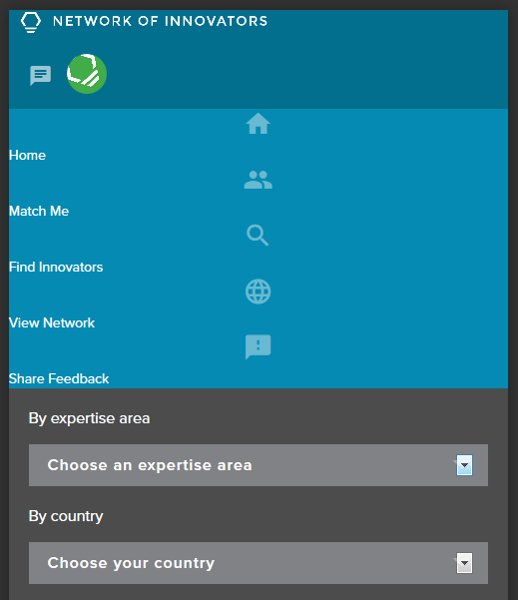
Network of innovators
Designed to find and offer expertise.
Especially useful between researchers and policy makers.
https://networkofinnovators.org

Slide 10
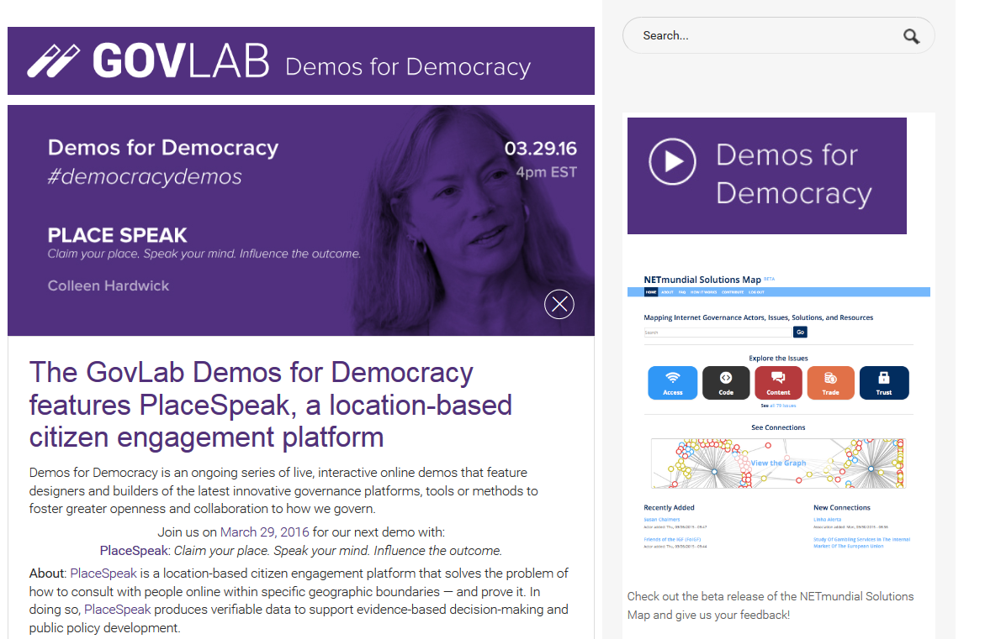
Demos for Democracy

Slide 11
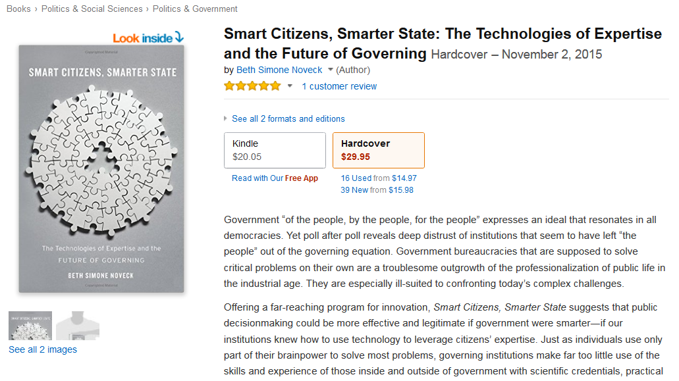
Smarter citizens, smarter state

Slide 12
Randomized trials of practices
Not only about making making research trials.
You should also make trials on how to make research.
Fail often, fail soon. Learn from it.
http://govlabacademy.org/ Learning to make a difference with expertise.

Slide 13
Wikipedia 15 years

Slide 14
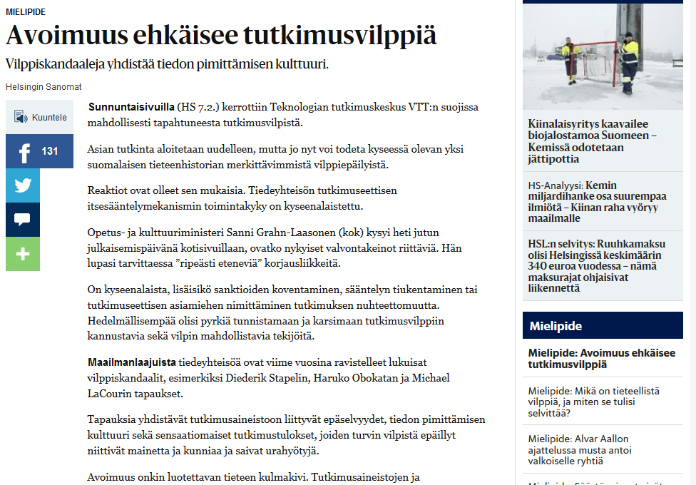
Avoimuus ehkäisee tutkimusvilppiä
Notes:
http://www.hs.fi/paivanlehti/11022016/a1455079306440 Heidi Laine ja Konsta Happonen 11.2.2016.

Slide 15
Knowledge crystal
Answers a specific research question.
Is located in a permanent place on the Internet.
Contains the best current answer to the question (in both machine-readable open data and text).
Contains all available data, information, and discussions needed to convince a critical reader that the answer is a good one.
Is continuously updated as new data appears.
Participation is open but implies specific rules.

Slide 16
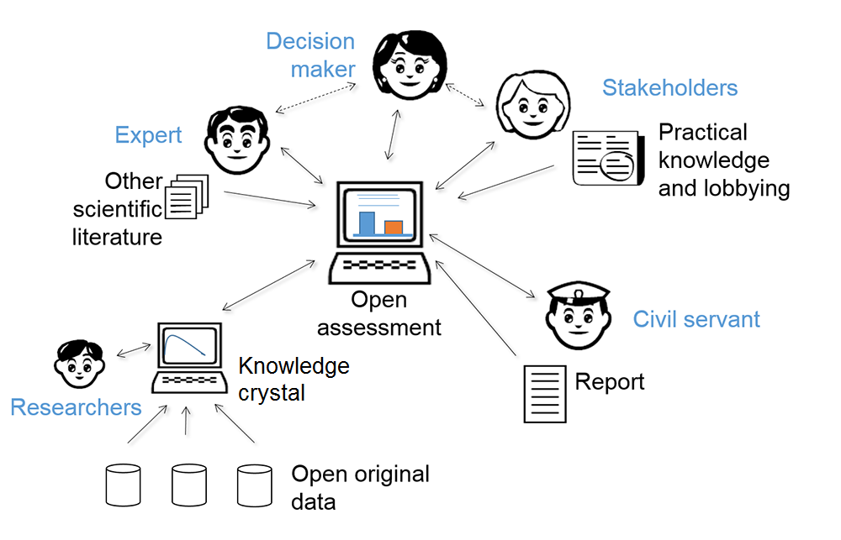
Collaboration in open policy practice

Slide 17
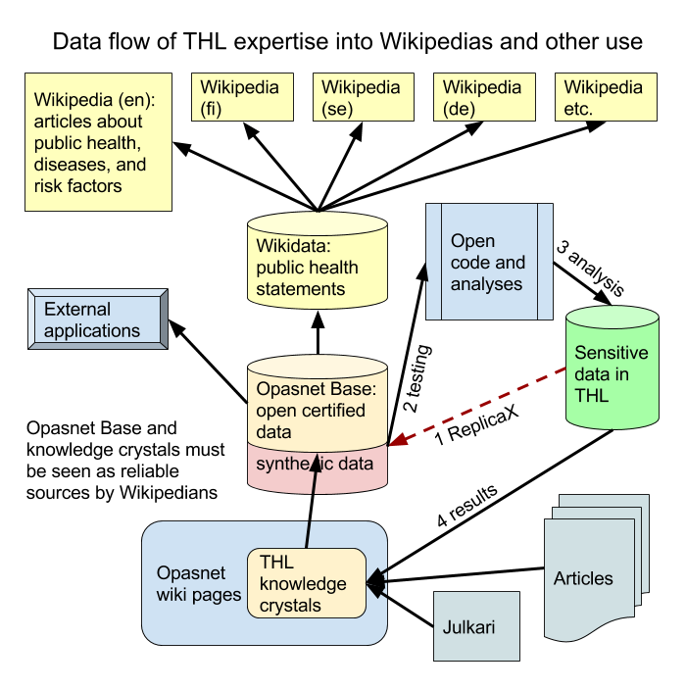
Data flow

Slide 18
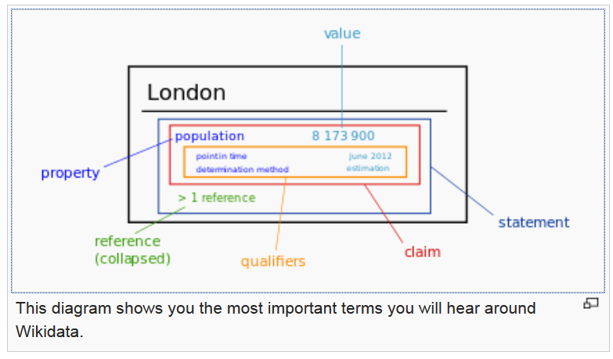
Wikidata

Slide 19
What could (people in) THL do?
Join the networks (Network of Innovators, OpenData500, Academy)
Plan how to open up data more effectively
Wikidata as the end storage.
Also data about the research itself could be opened up.

Slide 20
End

Slide 21
Knowledge crystals in an assessment

Slide 22
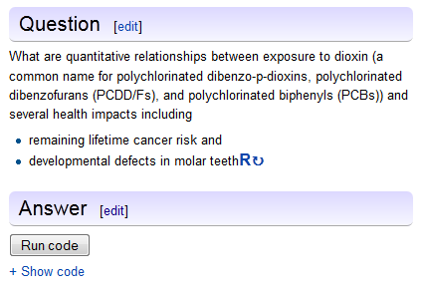
Collaborative models
Online models using open data, knowledge crystals and open source code.
Our choices on the Opasnet web-workspace:
R software, Mediawiki environment, Mongo DB
Anyone can run, explore, and comment.
No, this does not end up in chaos. Why?
Specific questions and topics.
Observations overrule opinions.
Contributions must hold against criticism.
The truth is consistent with all facts…

Slide 23
Examples of collaborative models
http://fi.opasnet.org/fi/Energiapaatos
http://fi.opasnet.org/fi/Silakka
http://en.opasnet.org/w/Health_impact_assessment
http://en.opasnet.org/w/ReplicaX

Slide 24
42
"I speak of none but the computer that is to come after me," intoned Deep Thought, his voice regaining its accustomed declamatory tones. "A computer whose merest operational parameters I am not worthy to calculate -- and yet I will design it for you. A computer that can calculate the Question to the Ultimate Answer, a computer of such infinite and subtle complexity that organic life itself shall form part of its operational matrix. And you yourselves shall take on new forms and go down into the computer to navigate its ten-million-year program! Yes! I shall design this computer for you. And I shall name it also unto you. And it shall be called ... the Earth."
-- Douglas Adams: The Hitchhiker's Guide to the Galaxy (1979)

Slide 25
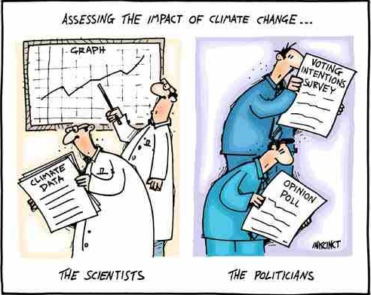
Assess-ments are to support decisions

