Slide 1
WP 3: Scenarios and management objectives
GOHERR: Kick-off 20-22 April 2015; Helsinki
Simo Sarkki & Timo P. Karjalainen
Simo.sarkki@oulu.fi
Timo.p.karjalainen@oulu.fi

Slide 2
People working in WP 3
Leader of the WP 3: Dr. Timo P. Karjalainen
Postdoc researcher in WP 3: Simo Sarkki
One PhD Student will be hired to work in the WP 3 (Call for applications has been opened in April 2015)
These people are based in Thule Institute, University of Oulu

Slide 3
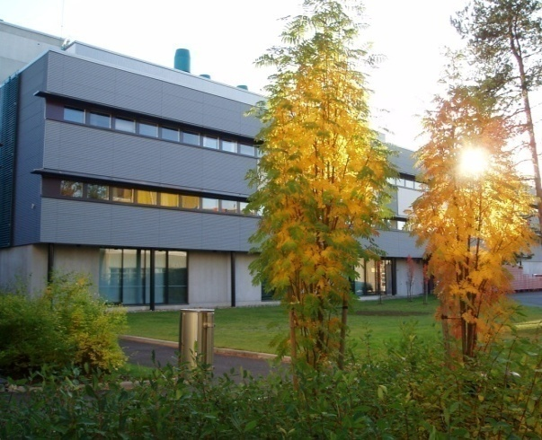
Thule Institute is a multidisciplinary research centre at the University of Oulu, which
studies environmental, northern and Arctic issues and natural resources
founds its research on a multidisciplinary research program and groups working in the program
multidisciplinary research themes are:
Climate Change Dynamics, Impacts and Adaptation
Human Health and Community Well-being
Sustainable Resources Management
takes part in national and international networks

Slide 4
The Thule Institute in numbers (2013)
Staff
Staff working at the Thule Institute 60
Doctoral students in PhD program 100
Joint research positions 5
Research activities
Articles in scientific journals 65
Doctoral theses in research programmes and PhD programmes 8
Arranged scientific conferences 8
Arranged international cources 8

Slide 5
Objectives of WP 3
Define objectives for integrated salmon and herring policy
Define pathways for reaching the objectives
Build exploratory future scenarios for euthropication and dioxin input in the Baltic Sea, and for the use of Baltic herring and salmon.

Slide 6
Some background
Need for reforms in Common Fisheries Policy leads to increasing needs to identify various objectives, prioritize them and search for integrative objectives that are able to balance economic, social and ecological goals in herring and salmon policy.
Value-focused thinking method will be used to map the objectives.
For exploring long term futures and objectives scenarios will be used
Expert workshops will be used for building scenarios regarding ethropication, dioxin input, salmon policy and the use of catches up to 2040.

Slide 7
Value-focused thinking (Keeney 1992, 1996)
Conventional approaches to decision making focus on alternatives.
Alternatives are relevant only because they are means to achieve values.
Thinking about decision situations should begin with values.
Value-focused thinking describes and illustrates concepts and procedures for creating better alternatives:
identifying decision opportunities more appealing than the decision problems, and articulating and using your fundamental values to guide and integrate decision making activities

Slide 8
DO we need theoretical introduction on value focused thinking, backcasting and exploratory scenarios??

Slide 9
Task 3.1 Defining desired future state and objectives for integrated salmon and herring policy (Month 12)
Views of multiple stakeholders on ecological, social, economic and human health related objectives will be involved in defining the objectives.
Brief literature review (and using the expertise of the consortium) to identify various existing objectives
Questionnaire study by the interneet survey tool (Webropol) to study divergent objectives, examine their links and identifying uncertainties in trends related to Baltic salmon and herring.
The results of questionnaire will be discussed and verified in stakeholder workshop (Month 10 ((Mention that this is joint WS with which WPs and note that we should start planning this WS in 22 April??). The workshop will also discuss and verify specific objectives that will be used in task 3.2.
Value-focused thinking is used to identify values behind specific management objectives.

Slide 10
Task 3.2: Identifying desireble future paths to reach the objectives
The specific objectives identified in task 3.1 will be here used as a background for ”backcasting” exercise.
Backcasting method is used to define desireble future pathways to reach the objectives (including what changes are needed; who should change and how, and proposed timeline for the changes).
Is backcasting done in workshop (Month 10, which is very crowded) or later???, and if later is it done in participatory way or by expert assessment??

Slide 11
Task 3.3 Building scenarios
To estimate future trends in euthropihication, dioxin releases, the use of herring and salmon policy. This provides input for decision support tool (WP 6).
Exploratory scenarios for Baltic salmon and herring use and governance
Exploring how key uncertanities: e.g. Globalization vs. regionalisation; ecosystem based governance vs. sectoral governance, impact on trends related to salmon and herring.
Input for scenarios from literature reviews (also from WP 2), stakeholder interviews (WP 2), the work on dioxin (WP 5) and expert workshops??.
Seeking to identify effective adaptive actions under each scenario.

Slide 12
Deliverables
D 3.1 Report / MS (Month 14), objectives and outcomes of baltic salmon and herring governance processes.
D 3.2 Input for decision support model WP 6, (Month 16), estimating trends in euthropihication, dioxin releases, the use of herring and salmon policy.
D 3.3 Report / MS (Month 20): Exploring plausible futures including potential effects of application of ecosystem based governance.
D 3.4 Report / MS (Month 24): Identifying normative future pathways via backcasting exercise and identifying adaptation measures under different exploratory scenarios.
D 3.5 Submitted MS, (Month 26): Developing scenario methodlogy in the context of complex multi-level fisheries governance.

Slide 13
Issues to discuss on 22 April
The expert stakeholder workshop in Month 10: what are needs for the WS by various WPs and what is realistic. Start planning of the workshop.
What are the needs of WP 6 decision support tool for WP 3, what are the deadlines and what kind of knowledge can be incorporated into decision support tool?
Other links between WPs: e.g. interviews, surveys and workshops designed for the purposes of various WPs to enhance effectiveness.

