Slide 1
Building stock in Helsinki
(Energy Parameters)
By: Aishat, Oluwatobi, Evans

Slide 2
Important Definitions
U-value : describes how well a building element conducts heat, the lower the value the better insulator a material is. In practice, it measures the rate of heat transfer through a building element over a building area under standard conditions.
G-values (solar heat gain) is a measure of how much heat from the external environ is transferred from exterior to interior of the building through the window . It is expressed as a value between 0 and 1, the lower the value the lower the solar gain.

Slide 3
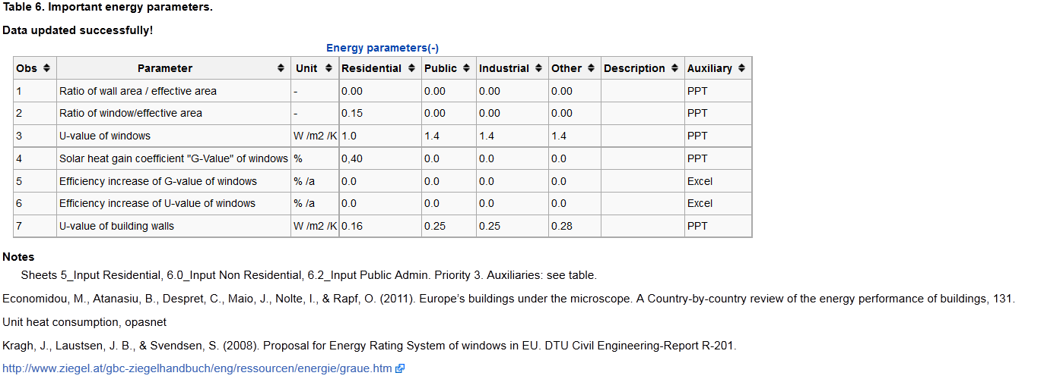
Helsinki Energy Parameters.

Slide 4
Improving U-value of Windows.
Double glazing with different gap and coating
Triple glazing with different depth and coating as well as argon fill.
Thanks for listening

