Slide 1
GOHERR meeting 2016:
WP5: Health impact model
16.-17.2.2016 COPENHAGEN

Slide 2
Aim of task 5.4
A probabilistic benefit-risk assessment will be performed to inform policy makers about the health impacts of fish.
This assessment will be combined with the results of the other WPs to produce estimates of future health impacts of Baltic fish related to different policy options.
These estimates will be used as input in the decision support model built in WP6.

Slide 3
Previous work done
Existing model applied to different environmental health issues
Air pollution (fine particles of energy production)
Dioxins (benefit-risk assessment of Baltic herring in Finland)

Slide 4
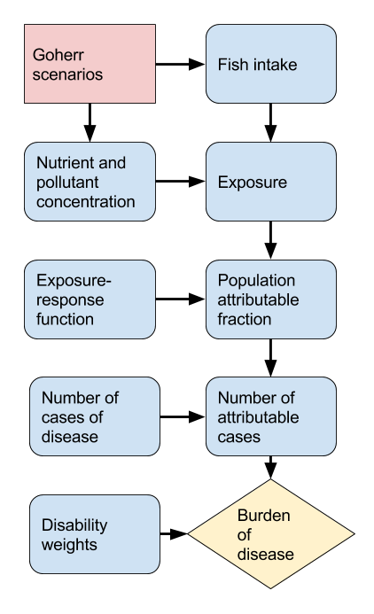
The updated model
Model works online with R.
Data needed is in an open database.
Modular structure: easy to modify.
Aim is to make a reusable model.
All content is visible and subject to criticism.

