Slide 1
Data collection for city baseline and projections for Helsinki
Building data

Slide 2
Objective
Scope and forecast
The objective is to build baseline of GHG, PM10 and NOX baseline for today and projections for 2020, 2025 and 2050 from building and transport.
Example data

Slide 3
Data quality
Please document
Source (web-link, name of report, etc)
Year of baseline data point
Type of baseline data (average city, example city, average national, etc.)
Quality of data point (statistics, extrapolated, calculated, etc)
Comment on assumptions and limitations

Slide 4
Priorities in excel input template
Yellow – mandatory input
Magenta – non-mandatory input (nice to have)
Grey – not for input (formula)
Parameter unit of measure and description | unit of measure | Baseline | Today | 2020 | 2025 | 2050 | Reference/Source | Year of baseline data | Type of baseline data | Quality of data | Comments & limitations
Electricity demand
Total electricity demand in baseline | Kilowatt hours per square meter per year (kWh/m2*a) |  | 0.00

Slide 5
Three selected categories
Building categories | Focus of Helsinki study
Residential
Government & public admin.
Non-residential
Commercial offices | -
Data centers | -
Education, K12 and university | -
Hospitals and healthcare | -
Hotels, hospitality and leisure | -
Exhibitions, fairs, halls | -
Retail, stores and shops | -
Warehouses & shopping mall | -

Slide 6
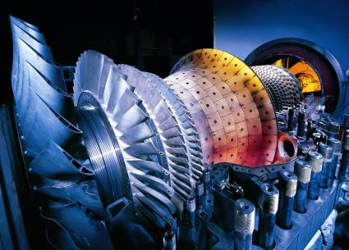
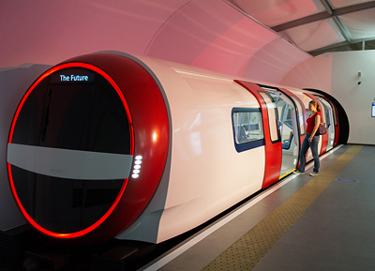
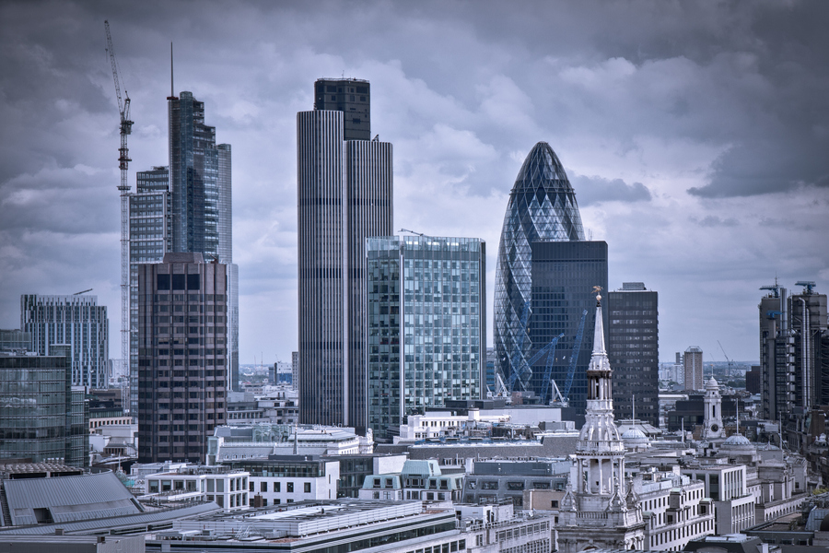
Data overview
General
5 data points
Population City population, density and growth
Emission targets Targets for CO₂, NO_{x} and PM₁₀
Energy
50+ data points
Consumption City`s annual energy consumption from electricity, heating and cooling.
Source mix City`s consumption source mix for electricity, heating and cooling.
Grid losses City`s transmission and distribution losses per KW generated power.
Transport
120+ data points
Passenger Annual passenger kilometer travelled inside the city borders and the split between travel modes.
Freight Ton kilometers of goods transported within the city borders annually, with split between road and rail.
Public transport service Length of network, number of vehicles and capacity utilization for passenger transport modes.
Vehicles and fuel source Private vehicles, taxis and trucks fleet distribution.
Roads and infrastructure Road network, traffic management and streetlights
Buildings
80+* data points
Floor space City`s total floor space, per building category.
Electricity usage The share of electricity split between lighting, ventilation appliances, per building category.
Building envelope The share of losses from heating and cooling building space, per building category.
*per building category

Slide 7
Building data Overview
General
5 data points
Population City population, density and growth
Emission targets Targets for CO₂, NO_{x} and PM₁₀
Energy
50+ data points
Consumption City`s annual energy consumption from electricity, heating and cooling.
Source mix City`s consumption source mix for electricity, heating and cooling.
Grid losses City`s transmission and distribution losses per KW generated power.
Transport
120+ data points
Passenger Annual passenger kilometer travelled inside the city borders and the split between travel modes.
Freight Ton kilometers of goods transported within the city borders annually, with split between road and rail.
Public transport service Length of network, number of vehicles and capacity utilization for passenger transport modes.
Vehicles and fuel source Private vehicles, taxis and trucks fleet distribution.
Roads and infrastructure Road network, traffic management and streetlights
Buildings
80+* data points
Floor space City`s total floor space, per building category.
Electricity usage The share of electricity split between lighting, ventilation appliances, per building category.
Building envelope The share of losses from heating and cooling building space, per building category.
*per building category:
Residential, non-residential

Slide 8
Basics
Buildings

Slide 9
Building data Floor space by building category
Example data
Floor space
City`s floor space in selected categories. Projections are not mandatory.

Slide 10
Building data (Per building category) Electricity, heating and cooling
Example data

Slide 11
Building data (Per building category) Walls and Windows
Example data

Slide 12
Building data (Per building category) Lighting

Slide 13
Advanced, non-mandatory
Buildings

Slide 14
Building data (Per building category) Annual efficiency change
Example data

Slide 15
Building data (Per building category) Technology baseline and restrictions
Example data
Technology baseline and restrictions
City`s level of existing implementation and upper limit of implementation level possible.

