Slide 1
Fish Consumption and Dioxin Exposure: Age-Specific Benefit-Risk Analysis of Baltic Herring
Jouni Tuomisto
THL, Impact Assessment Unit, Kuopio
Notes:
http://en.opasnet.org/w/File:BRA_of_Baltic_herring.pptx

Slide 2
Abstract
The objective of this study was to determine whether the benefits of eating Baltic Sea herring exceed the risks of dioxin exposure in Finland, and what the situation is in different age groups. Previous risk-benefit analyses have shown that eating fish is in general healthier than not eating fish, especially due to omega 3 fatty acids. However, the benefits are largely enjoyed by adults with an elevated risk of heart disease, while children suffer the majority of the harmful effects of dioxin exposure in the form of dental and other developmental disorders. We looked at different age groups separately in the light of current herring consumption. The results are based on a survey of the consumption in 2013. The results were expressed as disability-adjusted life years (DALY) per year. Omega-3 fatty acids eicosapentaenoic acid (EPA) and docosahexaenoic acid (DHA) as well as vitamin D were analysed as beneficial nutrients, and polychlorinated dibenzo-p-dioxins, polychlorinated dibenzofurans, and dioxin-like biphenyls as toxins. The results show that the consumption of Baltic herring has decreased in Finland. Based on current exposure concentrations and intakes of compounds, it causes ca. 11 (95% confidence interval, CI 0-54) DALY/a resulting from developmental disorders (dental damage); these affect children via the mother during pregnancy and breastfeeding. In addition, herring causes a ca. 12 (95%, CI 2–56) DALY/a cancer risk due to dioxins in the entire population. The health benefits (mainly to heart) of eating herring clearly exceed risks to health for women and particularly men after the age of 50 years, ca. -688 (95%, CI -2130 – -41) DALY/a. In conclusion, the health benefits in older age groups are clear, but the risks of dioxin exposure are low also in fertile females with current herring intake. Also other pollutants should be assessed simultaneously, especially methylmercury. This will be done in an EU-funded project GOHERR, which looks at ecological, economical, and health aspects of the Baltic Sea and especially herring.

Slide 3
POPs in Baltic fish Summary

Slide 4
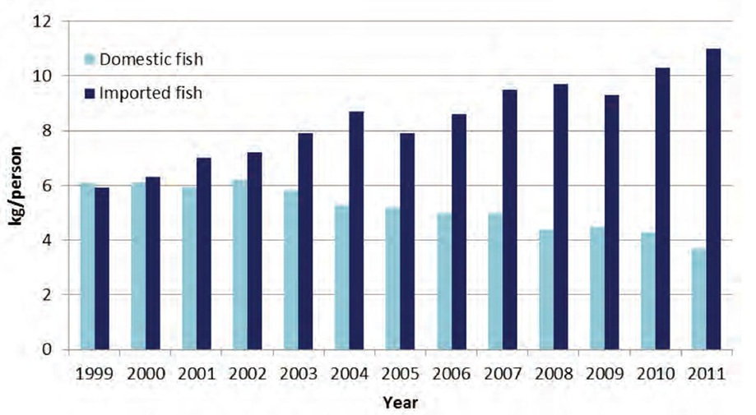
Fish consumption in Finland

Slide 5
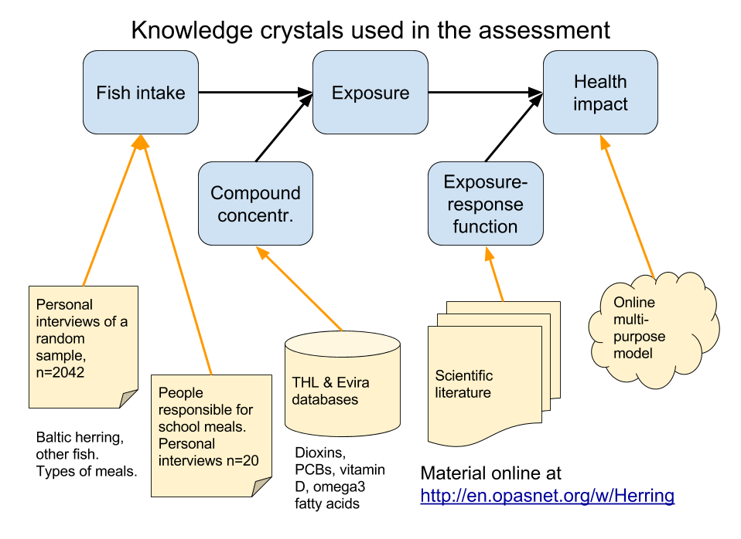
Knowledge crystals used in the assessment
Notes:
https://docs.google.com/drawings/d/1XgFfFTyBmeNtASzlMJiw2AMQ4xKnlFY6tuXv0cGLOv8/edit?usp=sharing

Slide 6
Methods
Personal interviews of 2042 random people between 15 and 79 years of age in Finland in 2013.
Questions about frequency and type of Baltic herring in diet. Also other fish consumption was asked.
In addition, a separate survey to 20 municipalities to people reponsible for meals in schools and day care centres.
Dioxin, PCB, methylmercury, omega-3 fatty acid and vitamin D concentrations in fish from previous studies by THL and Evira.
Exposure-response functions from scientific articles.
All data and model published online as knowledge crystals.

Slide 7
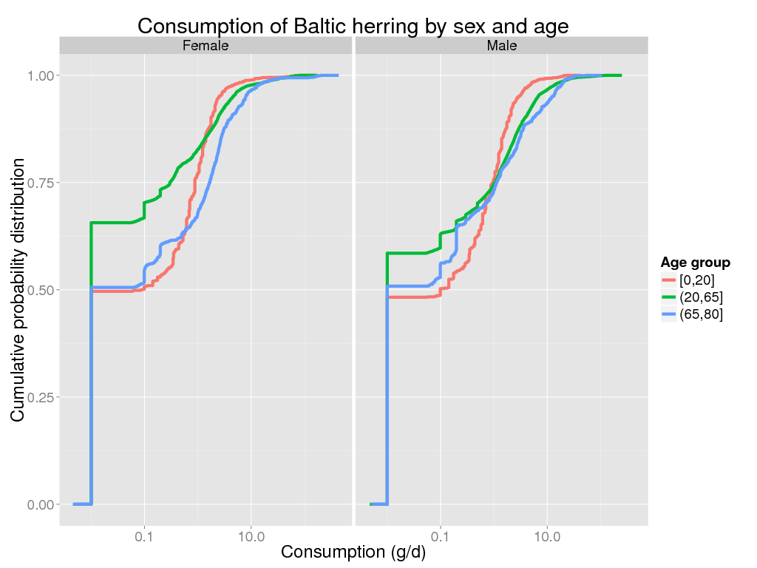
Consumption of Baltic herring by sex and age

Slide 8
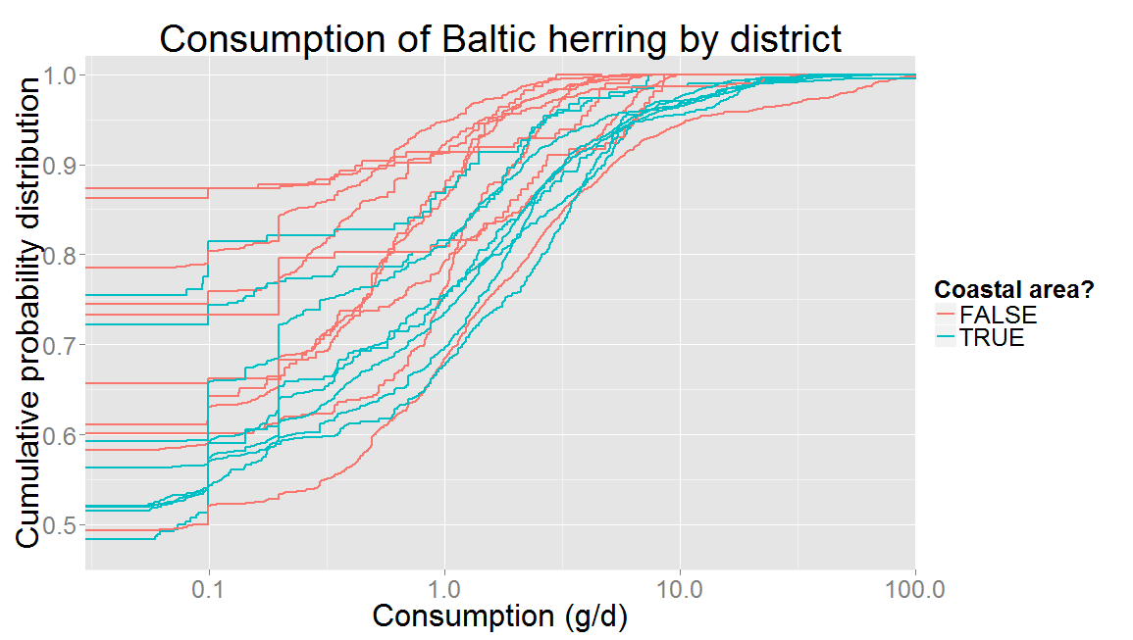
Consumption of Baltic herring by district

Slide 9
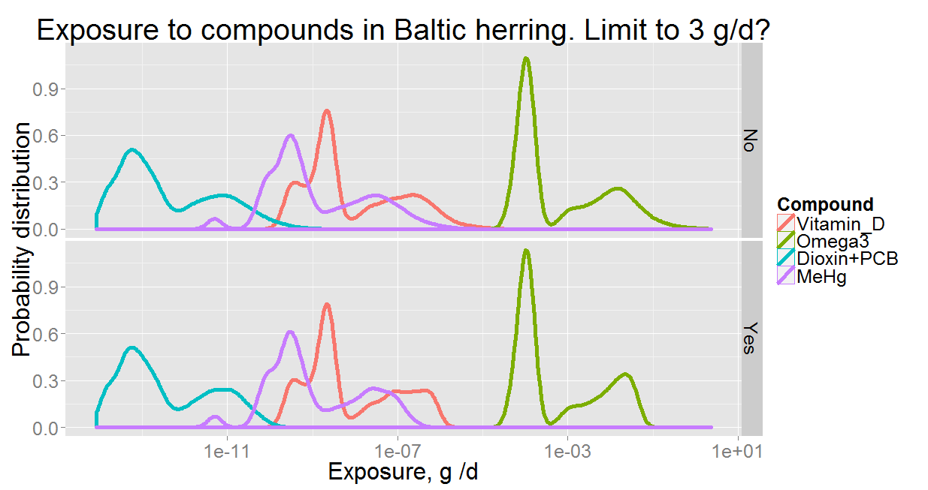
Exposure to compounds in Baltic herring

Slide 10
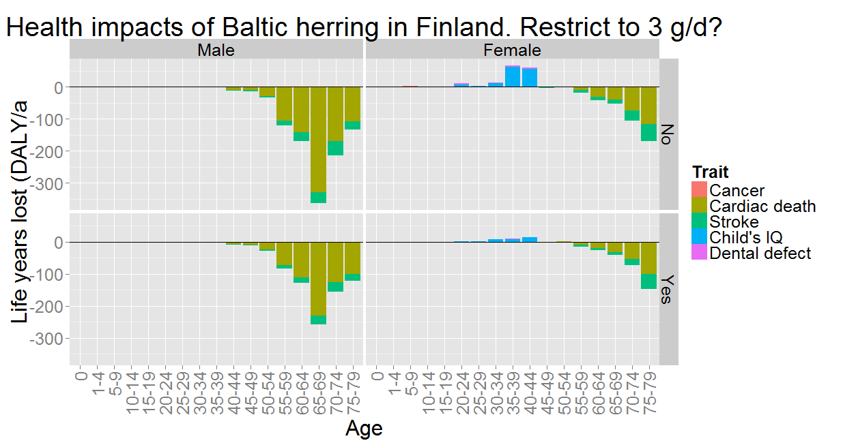
Health impacts of Baltic herring

Slide 11
Conclusions
For most age groups, Baltic herring is safe and nutritious food.
Health risks are small and only occur in children if mother eats a lot of Baltic herring before or during pregnancy and breast feeding.
Negative impacts of methylmercury are clearly larger than those of dioxins and PCBs.
Health benefits depend on other sources of nutrients (non-linear reponse functions).
The health impact model and all data are freely available as knowledge crystals online: http://en.opasnet.org/w/Herring
http://en.opasnet.org/w/Herring / Jouni Tuomisto

Slide 12
Acknowledgements
Finnish Food Safety Authority (Evira)
Anja Hallikainen, Tiina Ritvanen, Mervi Rokka
Natural Resources Institute Finland (Luke)
Hannu Harjunpää, Pekka J. Vuorinen
National Institute for Health and Welfare (THL)
Hannu Kiviranta, Marjo Niittynen, Jouni T. Tuomisto, Anu Turunen, Sari Ung-Lanki, Arja Asikainen

